Slide 1
GuidedStats
Yuqi Zhang, Will Epperson

Slide 2


Background
Statistical analysis is widely adopted, but easily misused for not following rigorous statistical procedures and violating assumptions
Thiese et al.: Statistics are often used to evaluate relationships in biomedical research, but inappropriate assumption dealing may leads to misuse of statistical tests and invalidated results.
Ernst and Albers: Incorrect dealing with assumptions of the standard linear regression model in clinical psychology are widespread and could lead to problematic validity.
¹ Thiese, Matthew S et al. “The misuse and abuse of statistics in biomedical research.” Biochemia medica vol. 25,1 (2015): 5-11.
² Ernst, Anja F, and Casper J Albers. “Regression assumptions in clinical psychology research practice-a systematic review of common misconceptions.” PeerJ vol. 5 e3323. 16 May. 2017.

Slide 3




Motivation
Current statistical analysis tools (R, Python, SPSS, STATA, etc.)
Provide limited instructions and explanations
Do not verify your decision choices (what test statistics should be used, what assumptions should be verified first)
Are either only UI or code based, but do not integrate both
UI-based
Code-based

Slide 4
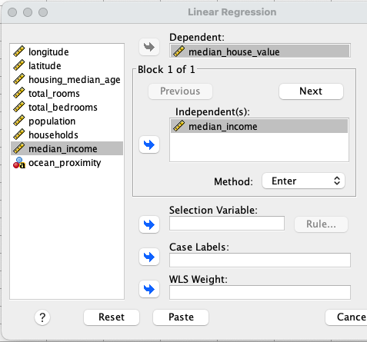

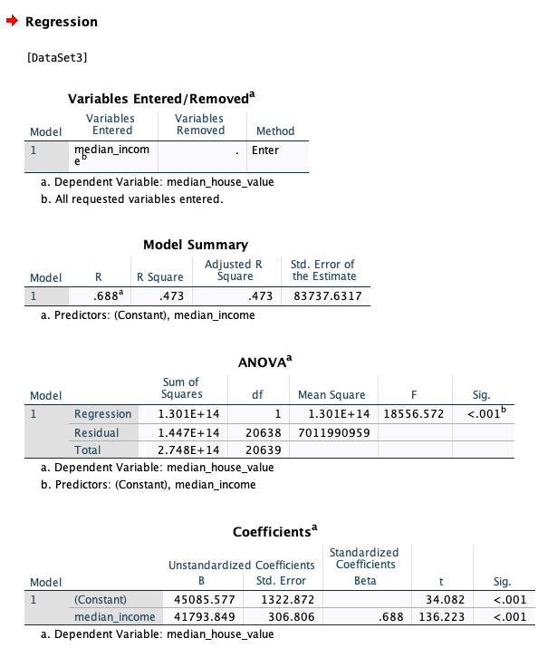
Motivation
UI automates the correct practices of workflow, but lacks the flexibility to adapt to specific tasks
➊ Click to select dependent variable
➋ Click to select independent variables

Slide 5
Motivation
Standard linear regression can be performed with few
But what if we would like to
Plot the density of variables to check their reliability?
Compare the prediction power of two models on a new dataset?

Slide 6
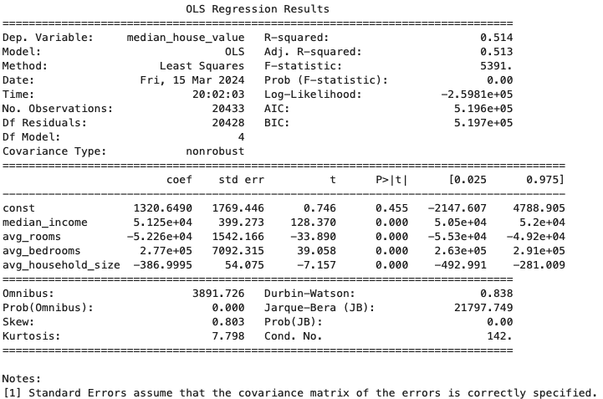
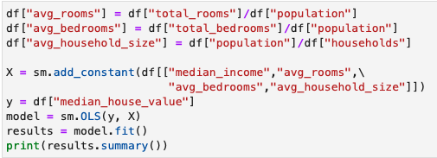
Motivation
Code has high flexibility to adapt to domain tasks, but lacks explicit instructions on workflows and cannot assure the correctness of steps
➊ Create variables based on requirements
➋ Fit model and print summary

Slide 7
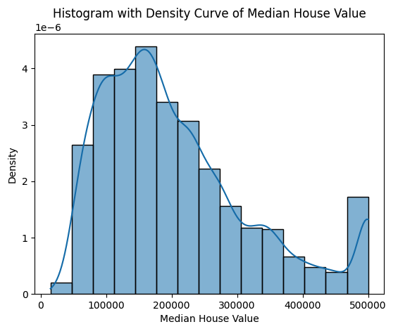
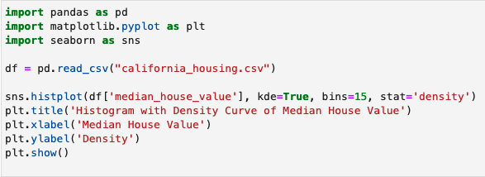
Motivation
Code has high flexibility to adapt to domain tasks, but lacks explicit instructions on workflows and cannot assure the correctness of steps
➌ Plot density curve for this specific dataset

Slide 8
Motivation
Code is customizable
But how we can assure that
The variables in OLS do not violate assumptions
The density plot is the correct way to inspect the variable

Slide 9
Motivation
A desirable statistical analysis tool:
Balance between code and UI: flexibility and sufficient guidance
Provides instructions on the procedures and explanations of statistical concepts
Automatically verifies assumptions and decision choices
UI-based
code-based
Notes:
Good tool should balance the trade-off: ui(automation, prefabricated correct steps), code(flexibility)

Slide 10
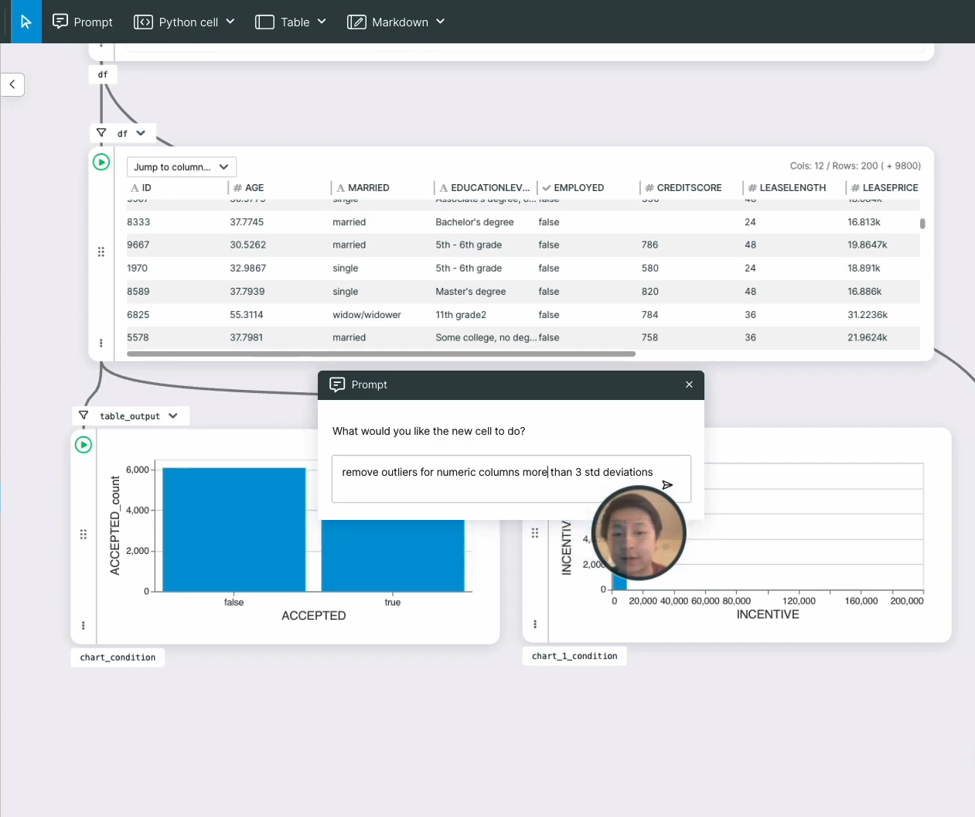

Related Work: Interactions parametrizing code
Parametrize data analysis code into interactions, allowing communication between code and interactions
Translating natural language questions into code-free interactive blocks for creating charts and models
Not conceptualized as meaningful steps in statistical practice(such as Step “Checking Assumption”)

Slide 11
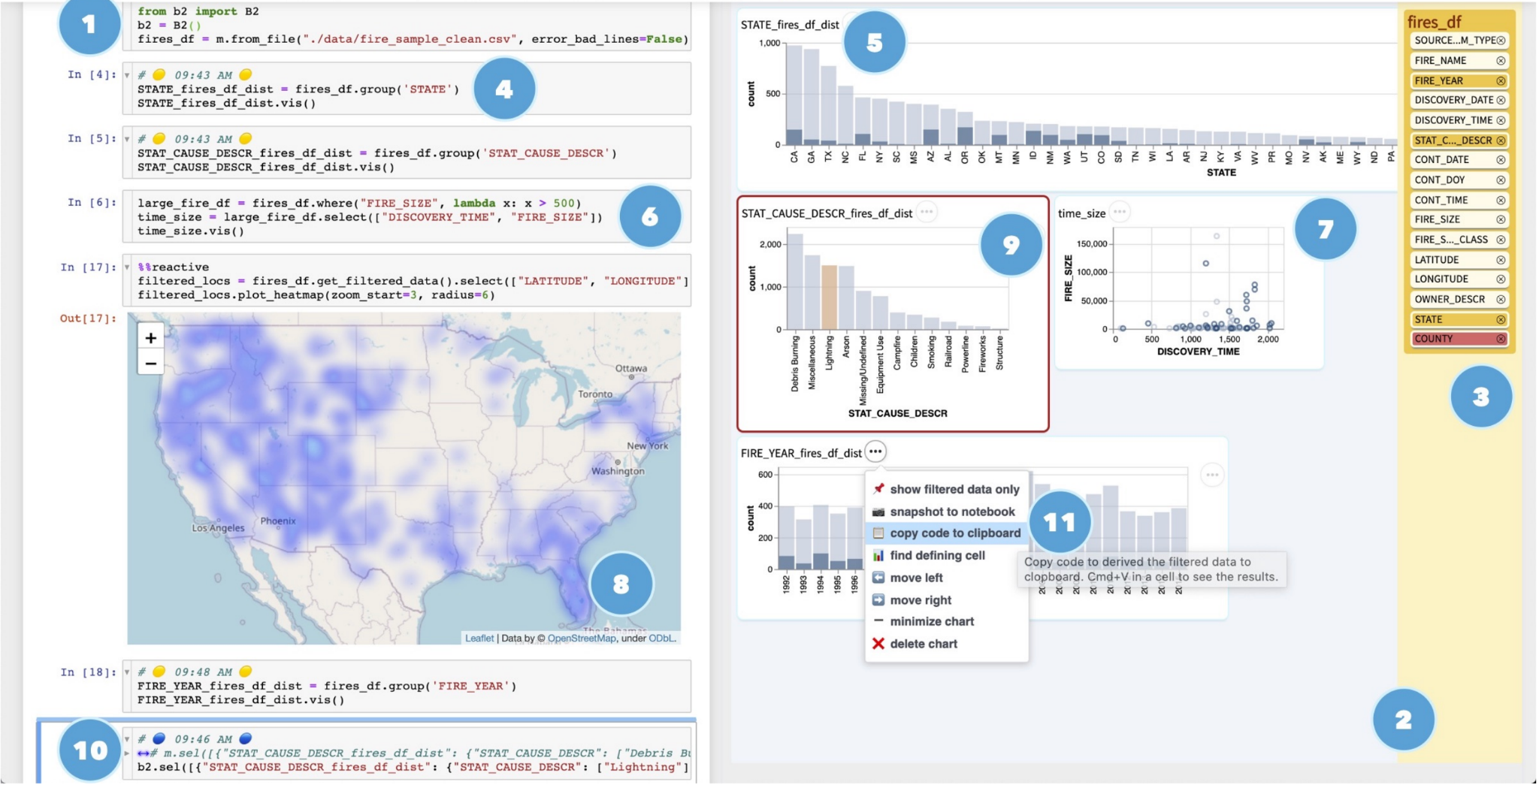
Related Work: Interactions parametrizing statistical analysis
Parametrize data analysis code into interactions, allowing communication between code and interactions
B2 synthesizes interactive visualizations with code queries, and export visualization or interaction history to code
The APIs(imports and exports) are not designed for further data analysis
¹ Y. Wu, J. M. Hellerstein, and A. Satyanarayan. B2: Bridging code and interactive visualization in computational notebooks. In Proceedings of the 33rd Annual ACM Symposium on User Interface Software and Technology, UIST ’20, p. 152–165. Association for Computing Machinery, New York, NY, USA, 2020.

Slide 12
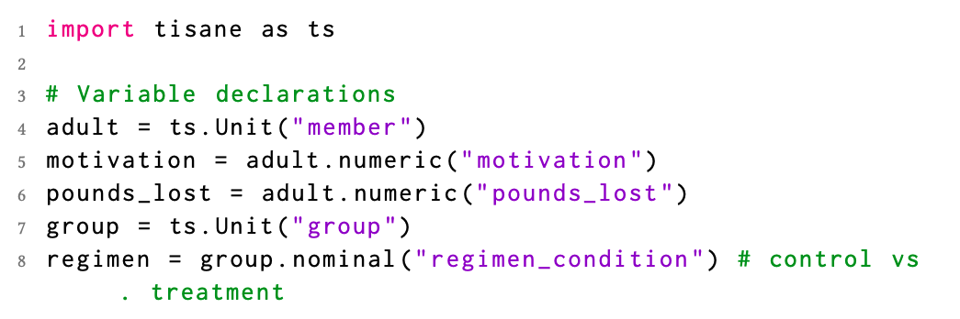
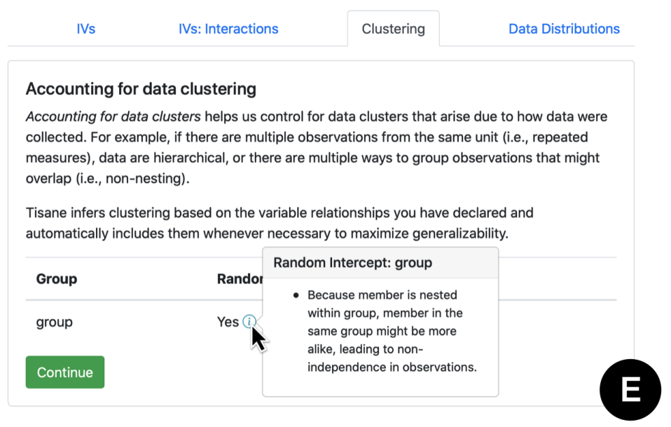
Related Work: Softwares for guided statistical analysis
Tisane authors generalized linear models: specification of variables, inferring candidate models, and asking follow-up questions to disambiguate model details
No iterative development of models
No interface communicating with code to support further data analysis
¹ E. Jun, A. Seo, J. Heer, and R. Just. Tisane: Authoring statistical models via formal reasoning from conceptual and data relationships. Proceedings of the 2022 CHI Conference on Human Factors in Computing Systems, 2022.

Slide 13
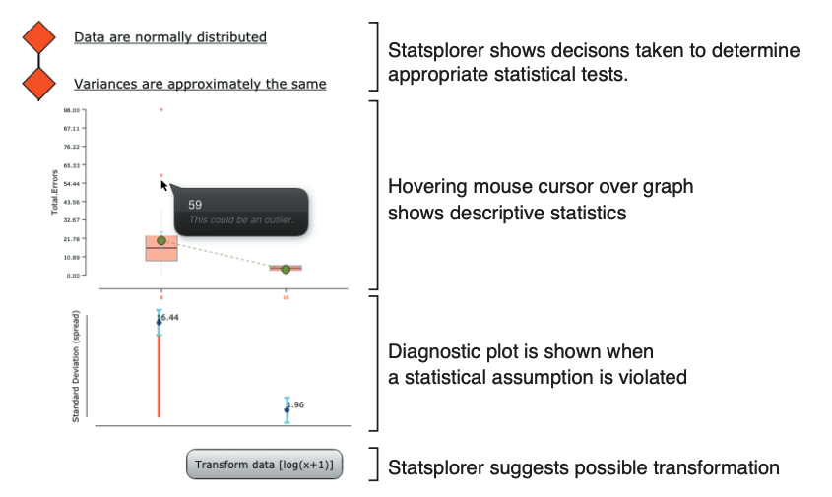
Related Work: Softwares for guided statistical analysis
Statsplorer automatically tests statistical assumptions and uses visualizations to guide in selecting statistical tests and interpreting the results
No guidance on next steps
UI-based, not allowing codes to communicate with UI(e.g., wrangling dataset)
¹ C. Wacharamanotham, K. Subramanian, S. T. Völkel, and J. O. Borchers. Statsplorer: Guiding novices in statistical analysis. Proceedings of the 33rd Annual ACM Conference on Human Factors in Computing Systems, 2015.

Slide 14
GuidedStats
Provides stepwise instructions on its usage to the analysis workflow and statistical concept explanation
Assumptions are automatically verified and well-explained
Seamless bidirectional communication between UI and code
Iterative: previous steps can be modified during the iteration of decision choices
Notes:
Code => UI: after EDA/data wrangling, takes wrangled or unwrangled dataset from argument
UI => Code: export regression table, short regression, dataset, the fitted model

Slide 15









System Design
Workflow
Dataset Loading
Variable Selection
Assumption Checking
Train Test Split
Modeling
Evaluation
Interface
Step
…
Explanation
Import
Export
…
Exploratory Data Analysis
Data Manipulation
Report
Dataset
Table
Model
Code
Import Data
Further Analysis

Slide 16

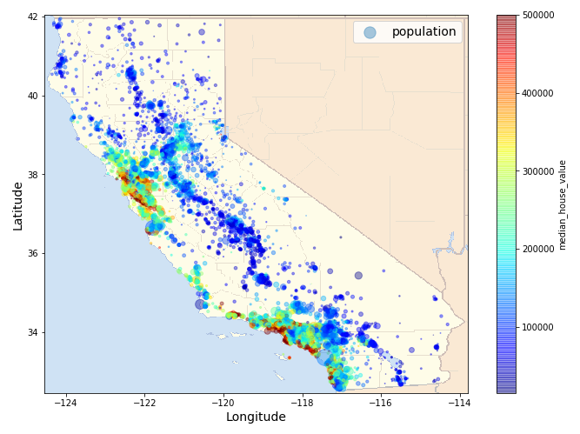
Use Case: Linear Regression(GuidedStats)
Statistical novice
Intermediate level of Python programming
User of Jupyter Notebook
The California Housing Prices Dataset
20,640 observations of median house value with 9 related characteristics of all the block groups in California

Slide 17
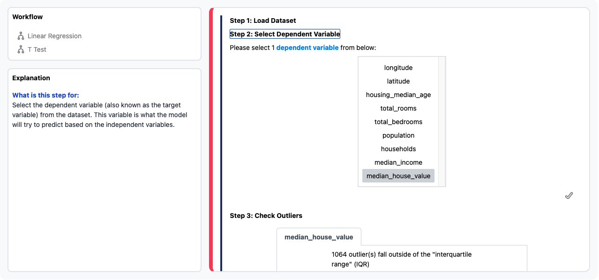
Use Case: Linear Regression(GuidedStats)
➊ Click to select “median house value” as dependent variable

Slide 18
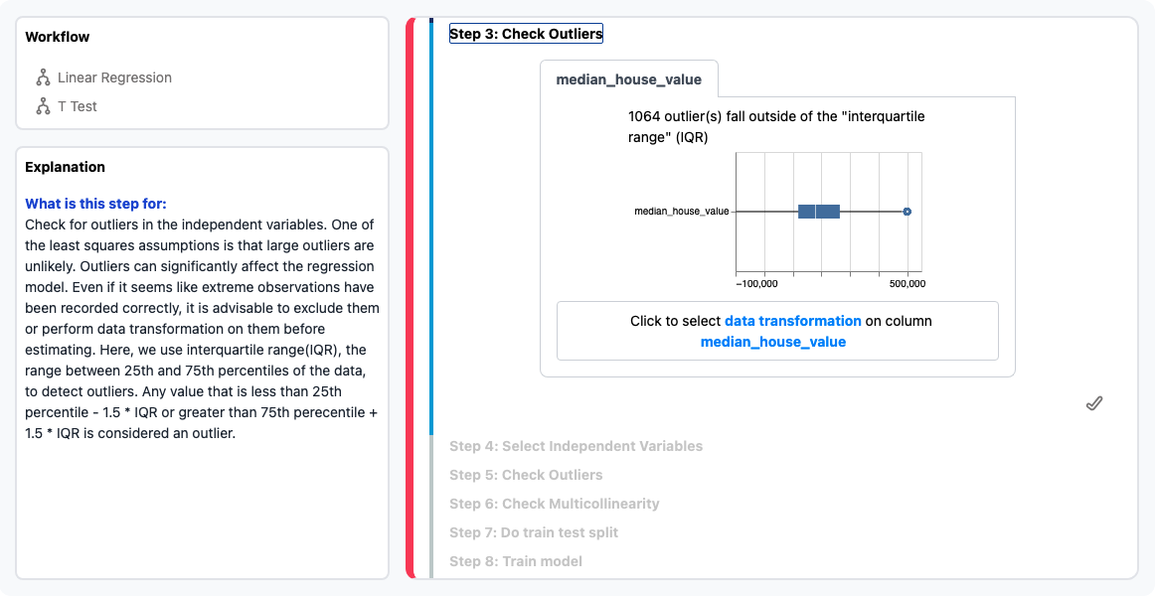
Use Case: Linear Regression(GuidedStats)
➋ Seeing outliers, user can decide to delete their rows or not
The explanation block explains why users should check outliers and the definition of outliers

Slide 19
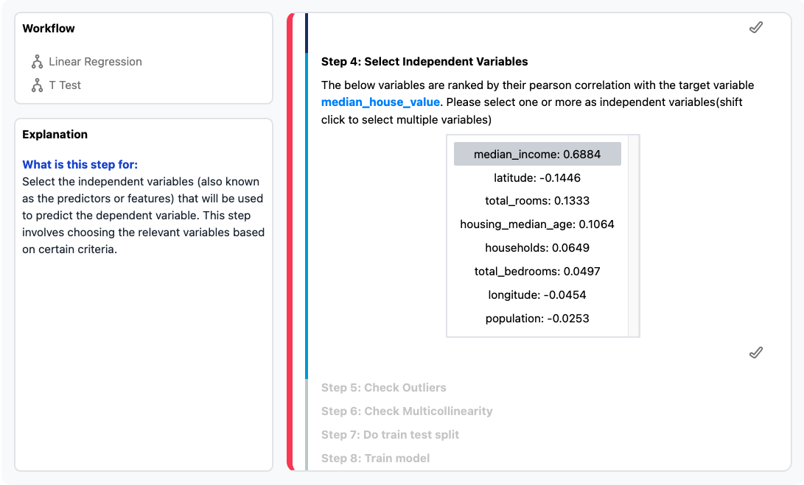
Use Case: Linear Regression(GuidedStats)
❸ Select “median income” as independent variable

Slide 20
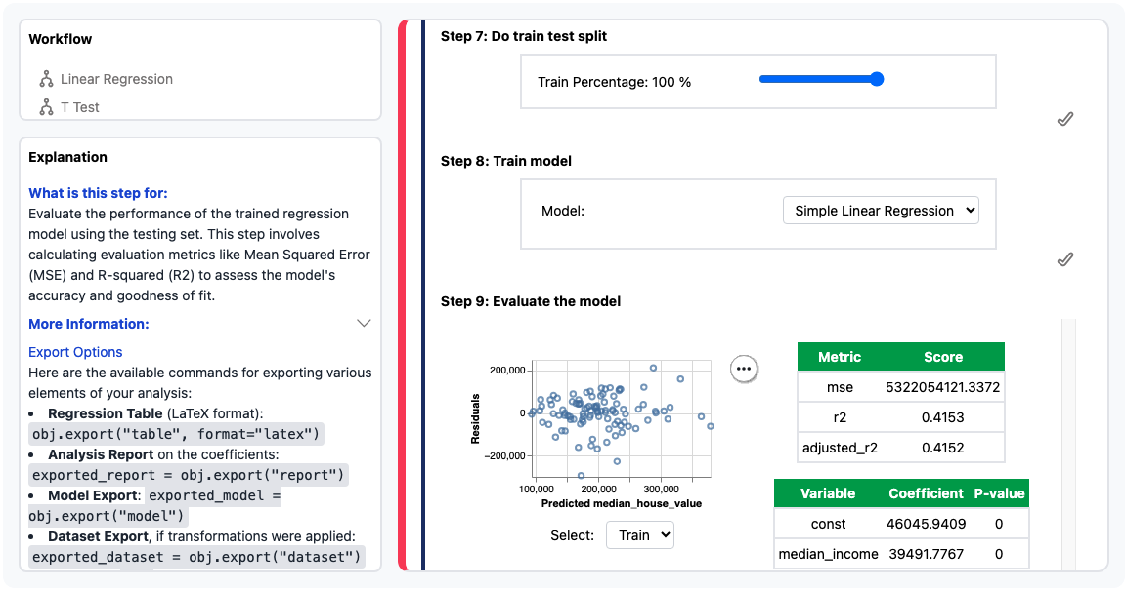
Use Case: Linear Regression(GuidedStats)
❹ Select training set size and model
❺ Evaluate the model using metrics and residual plot
❻ Refer to the explanation block to learn how to export

Slide 21
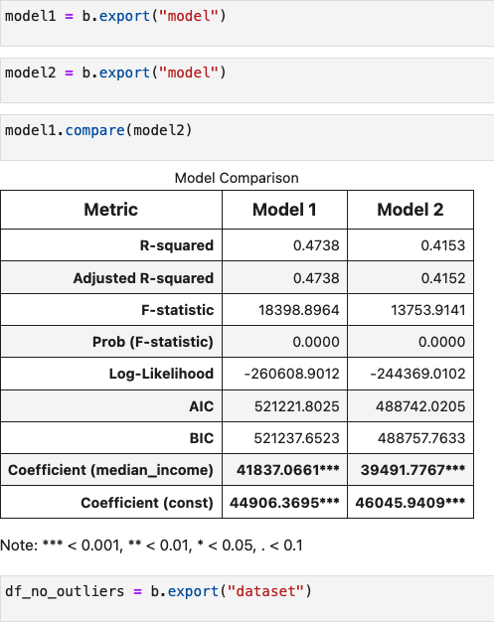
Use Case: Linear Regression(GuidedStats)
Previously exported model with outliers
❼ Export the model without outliers
❽ Compare two models
➒ Export the dataset without outliers

Slide 22
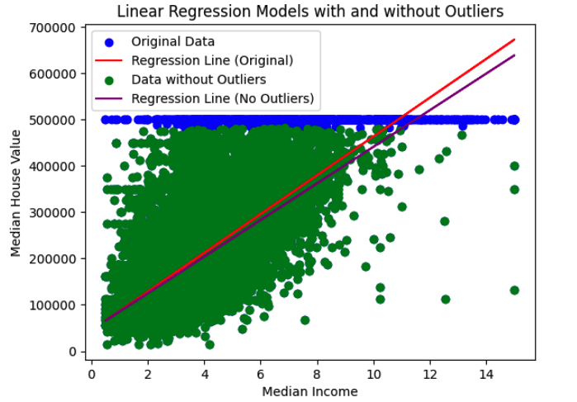
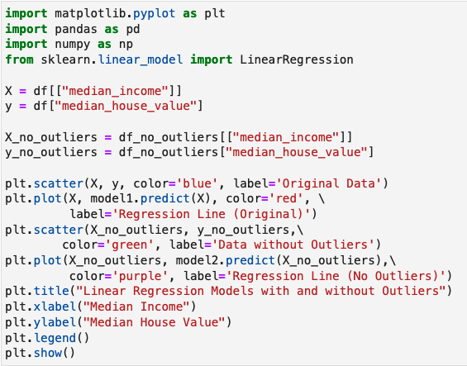
Use Case: Linear Regression(GuidedStats)
❿ Plot two models with training data

Slide 23
Future Work
Support more common statistical practices:
Chi-squared Test
ANOVA
More flexible:
In-situ comparison of models
Allowing adding steps to workflow
Self-defined steps/workflows
Incorporate more high-level data analysis tasks:
Kandel et al.: common data analysis process - discovery, wrangling, profiling, modeling, and report
Variable profiling
Common data transformation
¹ S. Kandel, A. Paepcke, J. M. Hellerstein, and J. Heer. Enterprise data analysis and visualization: An interview study. IEEE Transactions on Visualization and Computer Graphics, 18:2917–2926, 2012.

Slide 24
Questions for feedback
Background: Misuse of statistics exists in many study fields, what would be best motivation for the paper?
Related work is divided into two parts: Interactions parameterizing statistical analysis, Softwares for guided statistical analysis.
Is this division reasonable?
Are there any other research fields should be addressed?
Is the use case convincing?
Should it be compared with the cases where users perform the same data analysis task with UI-based only or code-based only tools?

